Slide 1


SAP UI5 & FIORI with OData TRAINING using BAS
Anubhav Oberoy
Day – 10

Slide 2
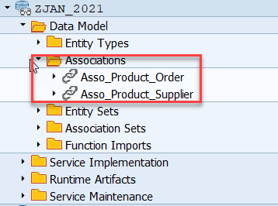
Association
Associations are relationship Between entities.
At database level we have foreign key relationship and same is reflected at odata level.
Once a association is created only then we can create navigation property.
In a typical ERP system the data is spread across multiple database tables. Example sales order header and items. We load this connected data using the foreign key relationship.
In case of OData service, each database table is transformed into an entity. Hence we also need a relation between these entities. So the foreign key is converted to a association.
Product
Supplier
1 relation 1

Slide 3
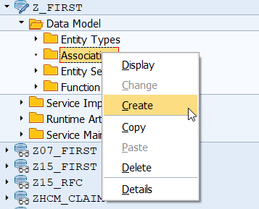
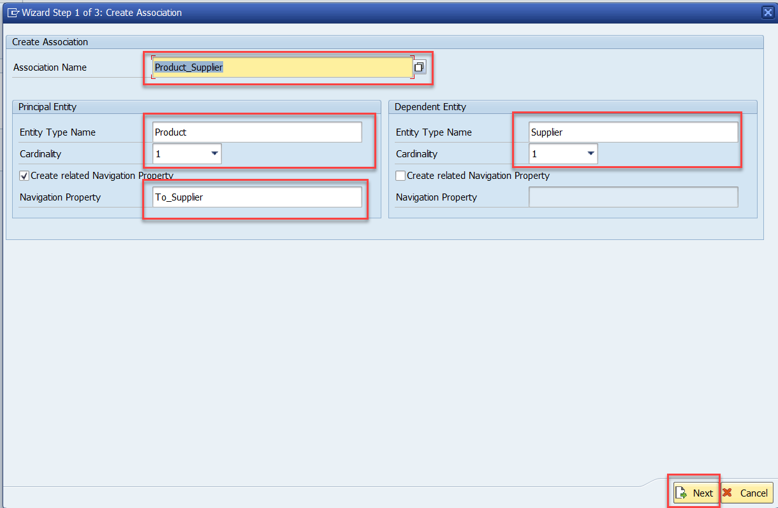
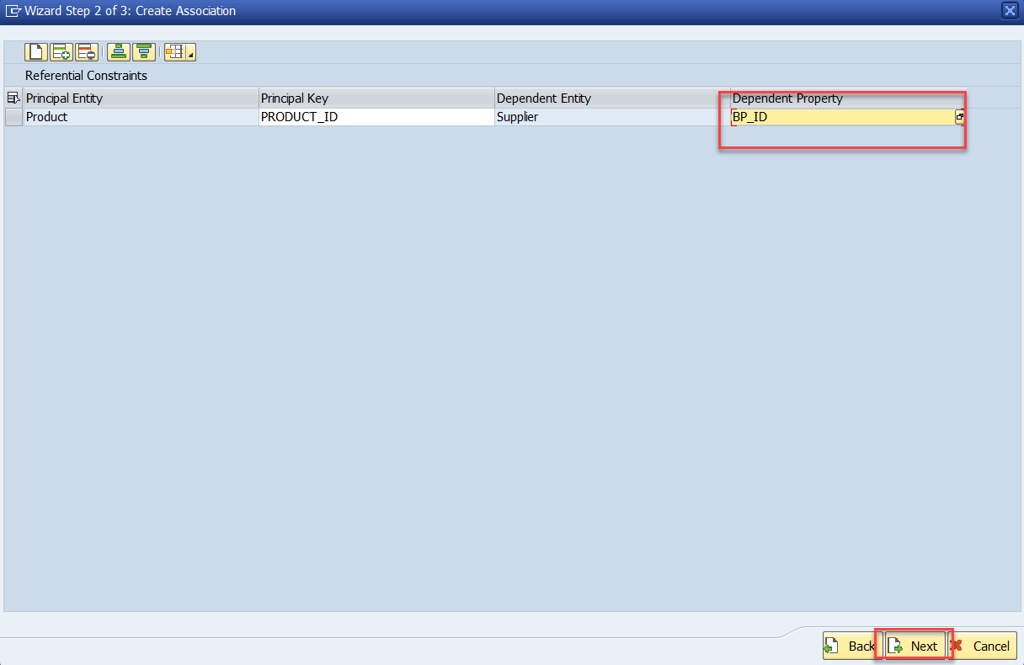
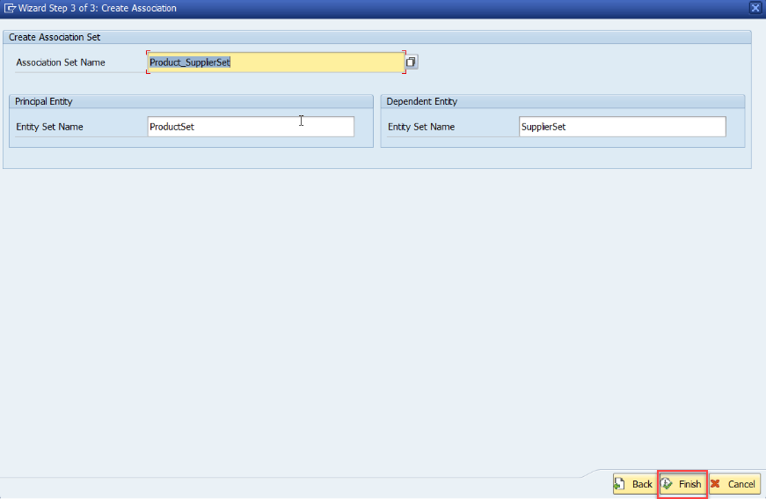
Association (1:1)
Step:1 Right Click on Association and click on create
After creating the Association for Supplier Set in Product Set, we need to change the Supplier Get entity.
Code Link:
SUPPLIER_GET_ENTITY (Association)

Slide 4
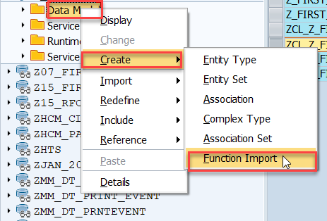
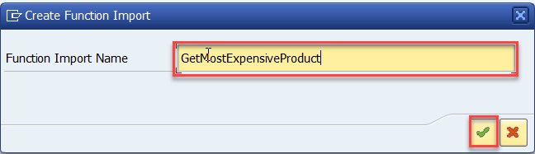
Function Import
At times, we need to implement the logic inside of OData which is not a direct CRUD operation e.g. calling a workflow, calling a BAPI which does some processing, Sending request to another server and can be invoked by the HTTP methods GET or POST .
For example: we can create the function import to GetMostExpensiveProduct in our Product set by the Category.
Step1: Right click the Data Model folder and select Create and then select Function Import. Create Function Import dialog opens

Slide 5
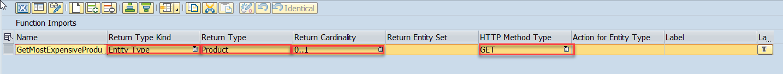
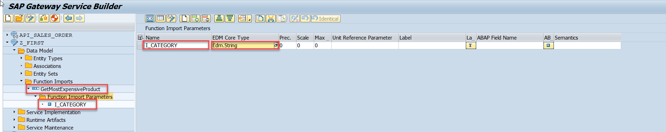
Function Import
Step2: Enter return type kind, return type, return cardinality & HTTP method Type
Step3: Giving function import parameters (I_CATEGORY)

Slide 6
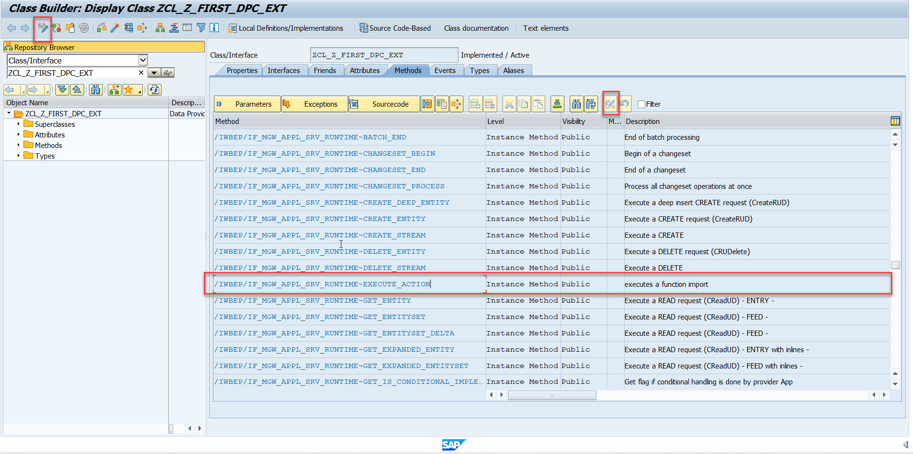
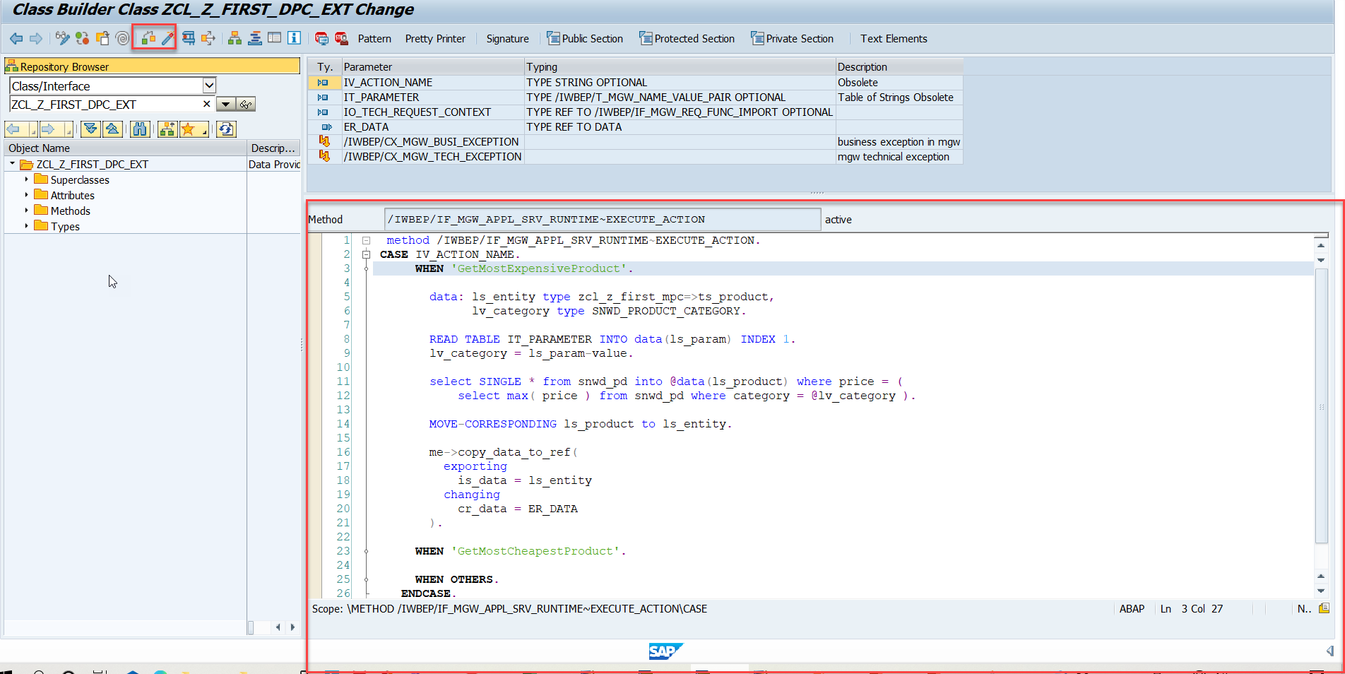
Function Import
Step4: Go to DPC Extension and search for the method--/IWBEP/IF_MGW_APPL_SRV_RUNTIME~EXECUTE_ACTION and redefine the class method
Function Import Code: funciton_import

Slide 7


Basics of Connectivity and Role of SCC
Internet
Intranet
SAP BW
SAP ECC
SAP S/4 Hana
SAP BTP (PublicCloud)
SAP Cloud Connector
SAP On-premise System
SAP Business Application Studio
SCC
Destination
S/4 Hana Cloud
Field Glass
Sales Force

Slide 8
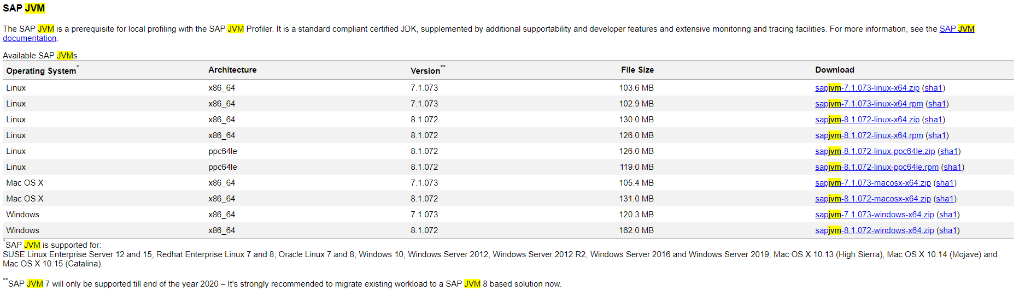
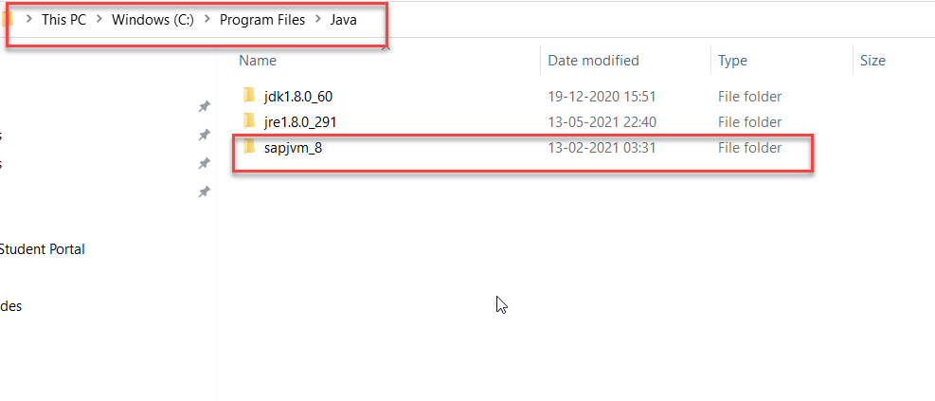
Cloud Connector
Step 1: Download SAP JVM and Extract it in the C:\Program Files\Java

Slide 9
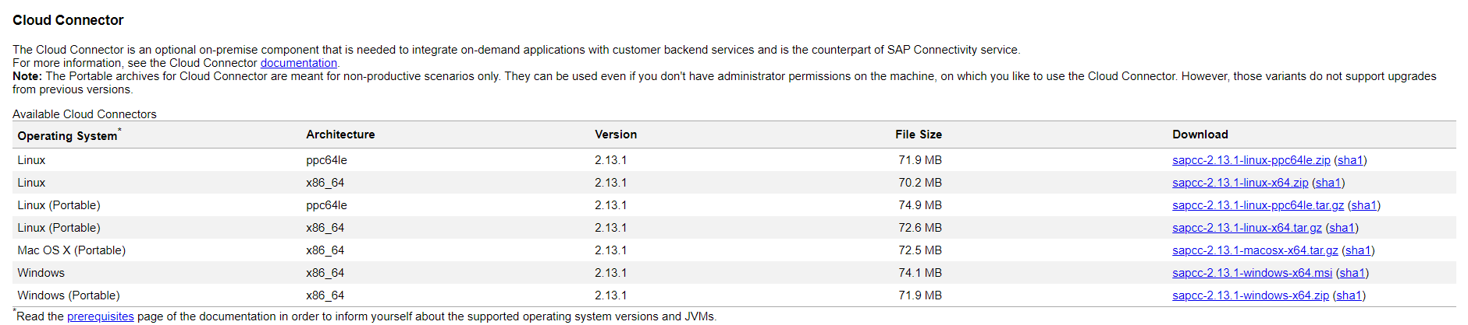
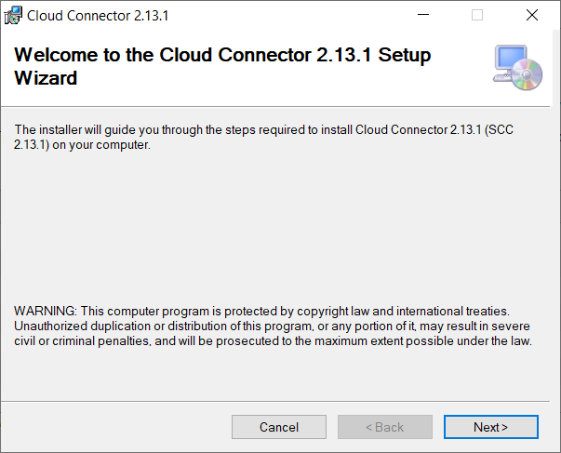
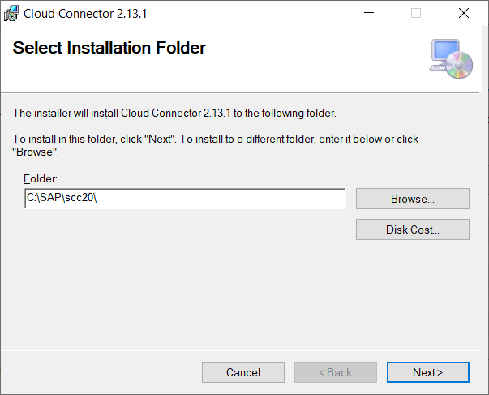
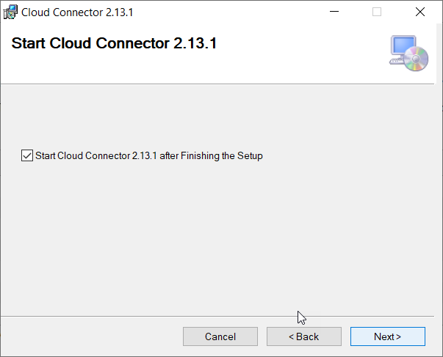
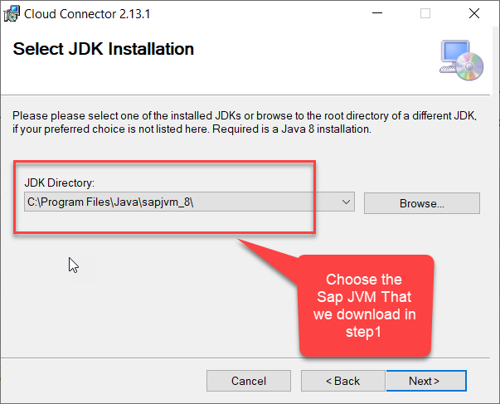
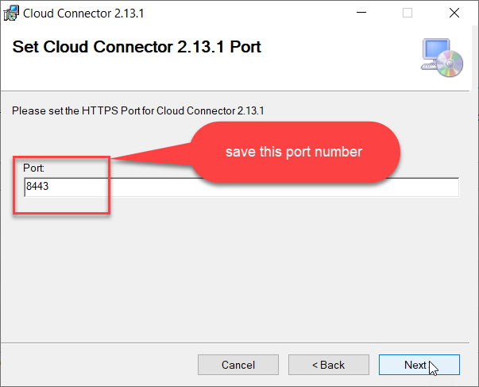
Cloud connector continue…
Step 2: Download and install the sap Cloud connector

Slide 10
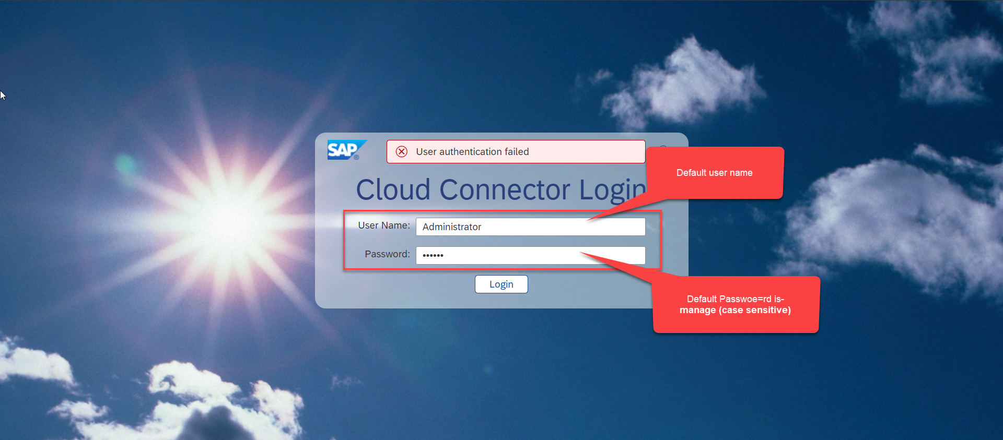
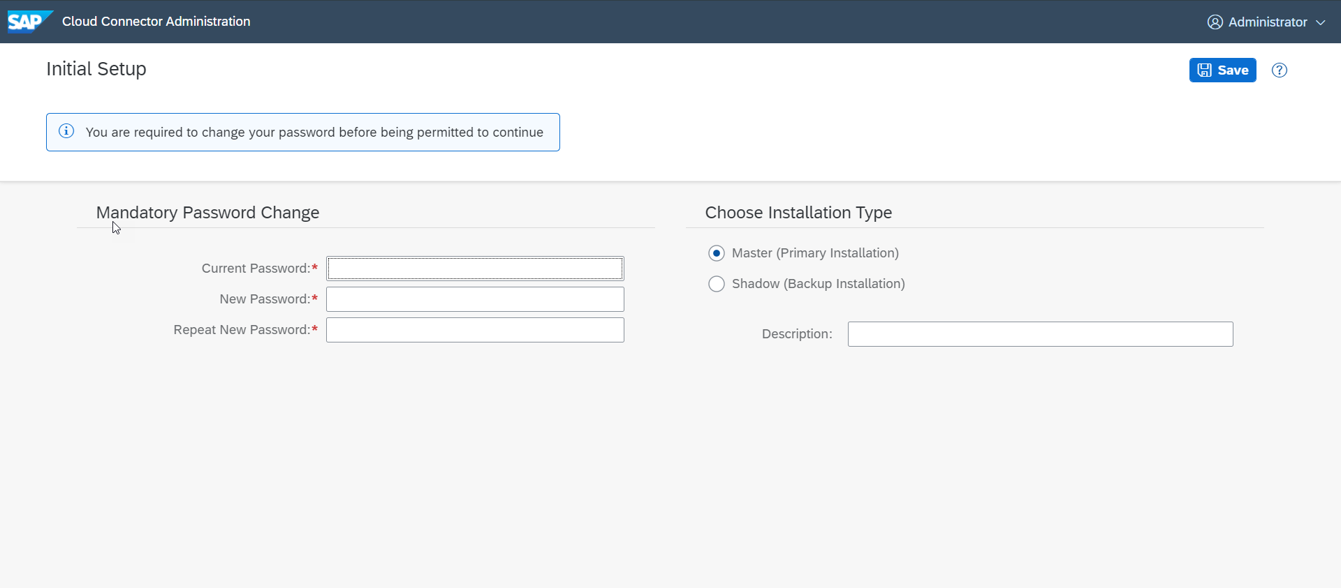
Cloud connector continue…
Step 3: Now your system is ready go to browser and open https://localhost:8443 (port may changes)
The default credentials are Administrator / manage

Slide 11
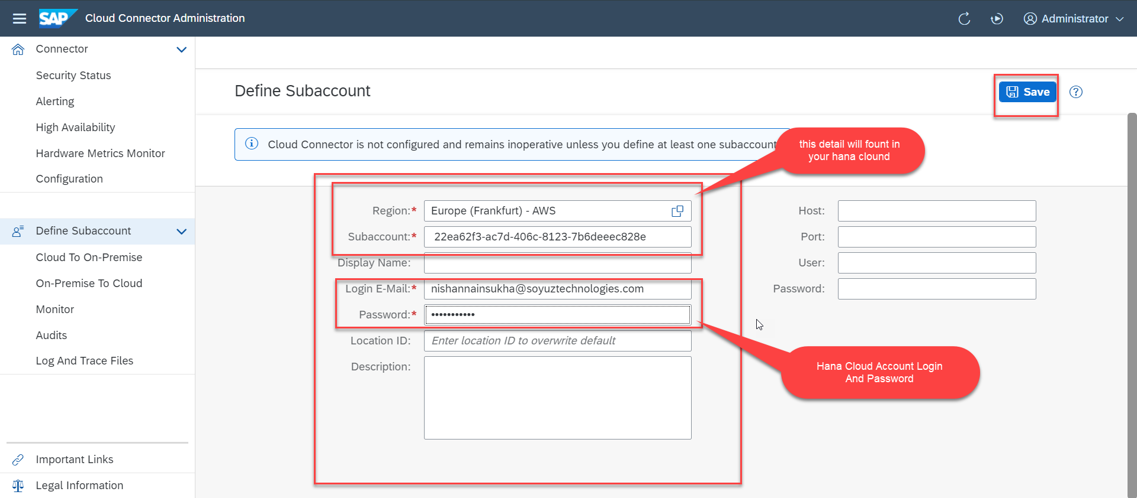
Cloud connector continue…
Step 4: Now we create a connection with our Cloud Account

Slide 12
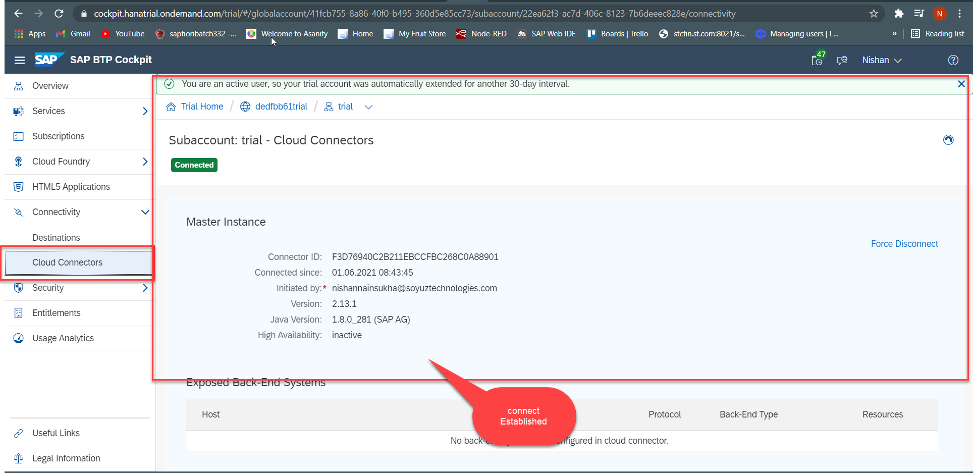
Cloud connector continue…
Step 5: Check the connection on Hana Cloud Account

Slide 13
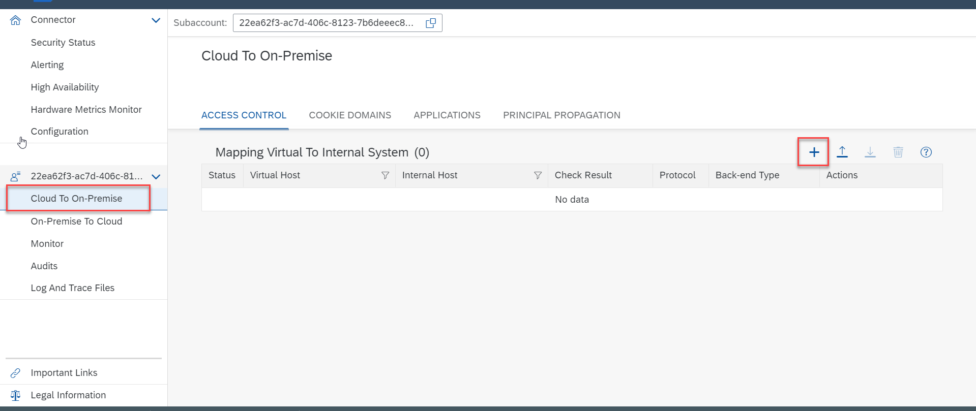
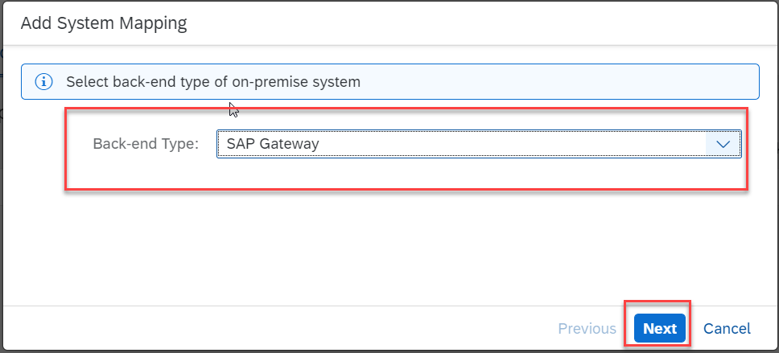
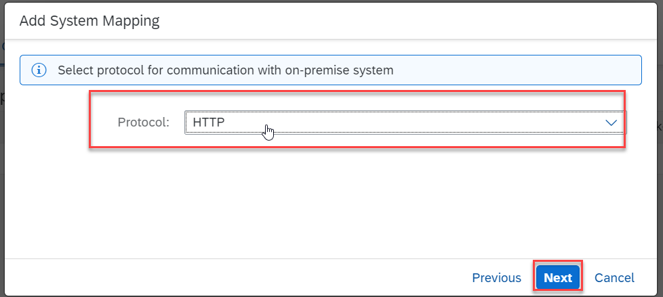
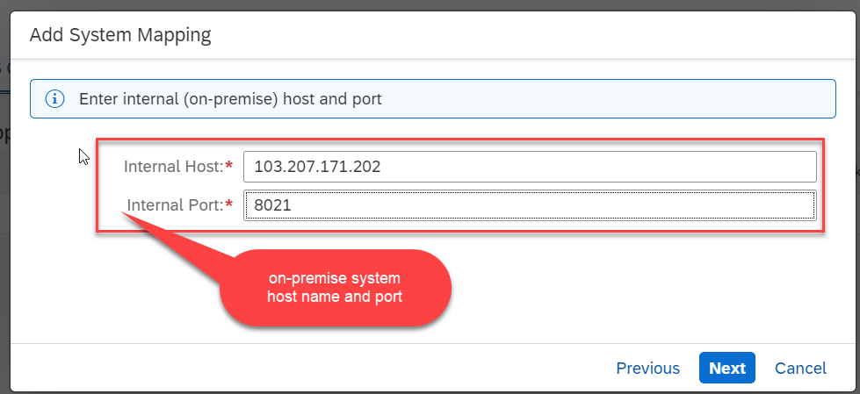
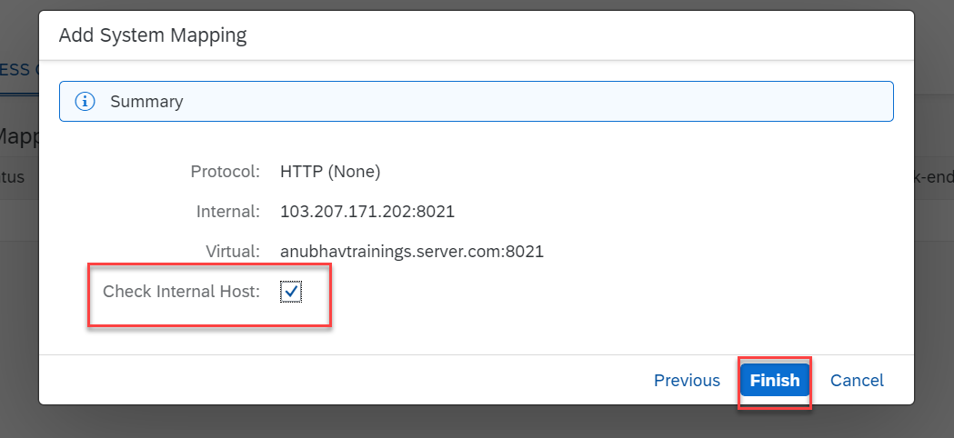
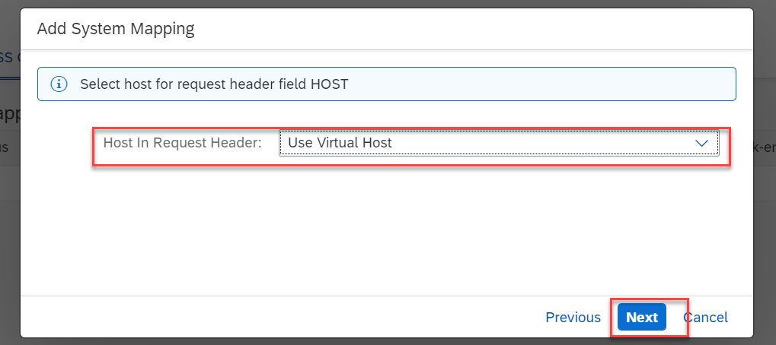
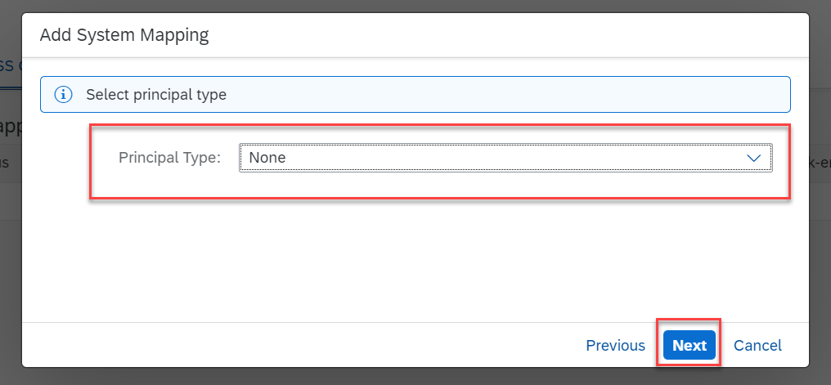
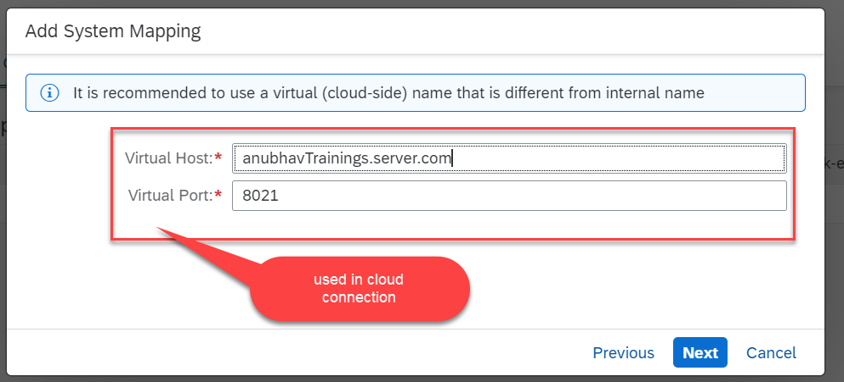
Cloud connector continue…
Step 6: Connect on-premise system to cloud using SCC

Slide 14
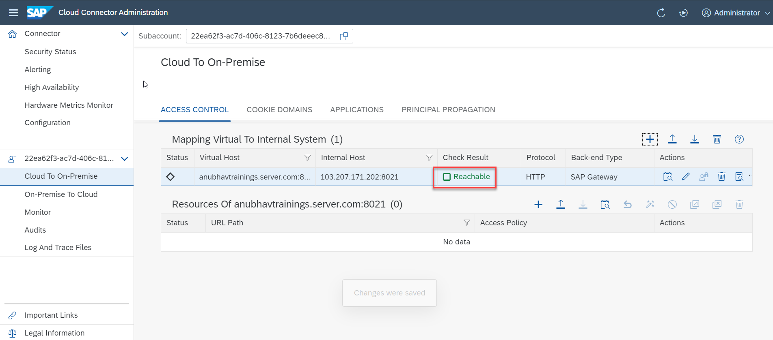
Cloud connector completed
We have Done with Connect , now we are now successfully connected to cloud using SCC.

Slide 15
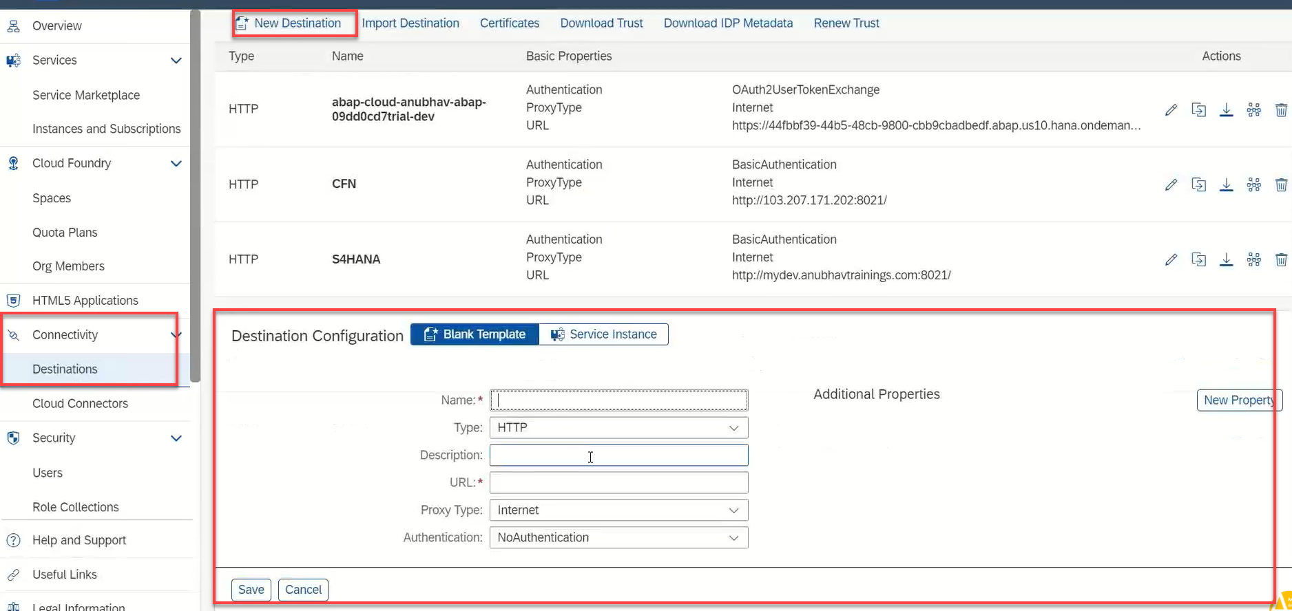
Creating the Destination in BTP
Now once the cloud connector setup is done. We need to create a destination in the Business Technology Platform (BTP) to assess our SAP system in the BAS.
There are two ways to create a destination in BTP:
Create a destination directly in BTP (Not Recommended)
Creating the destination inside the BAS (Recommended)
To create a destination directly in BTP
Go to the Connectivity > Destinations and here click on New Destination
Then a new Destination Configuration will open.
Enter all the details of the system and press save.
After that check the connection with destination.
This way of creating destination is not recommended because in this method, to assess the odata service in the fiori application some additional properties are required. Adding that properties is a little tricky and can lead to error.
That’s why we will not use this method.

Slide 16
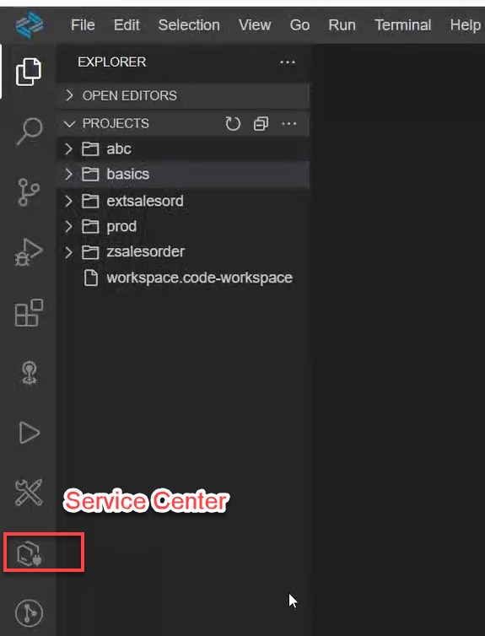
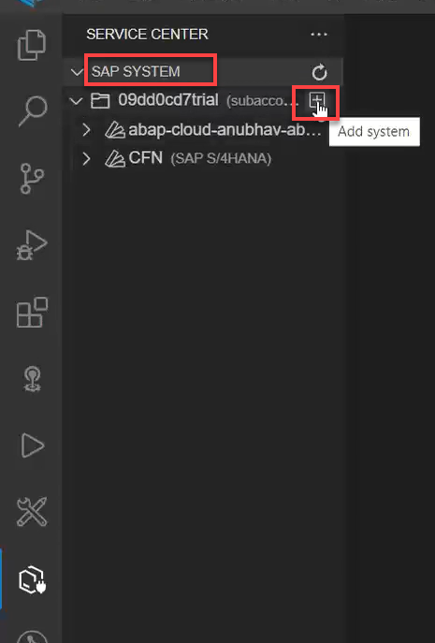
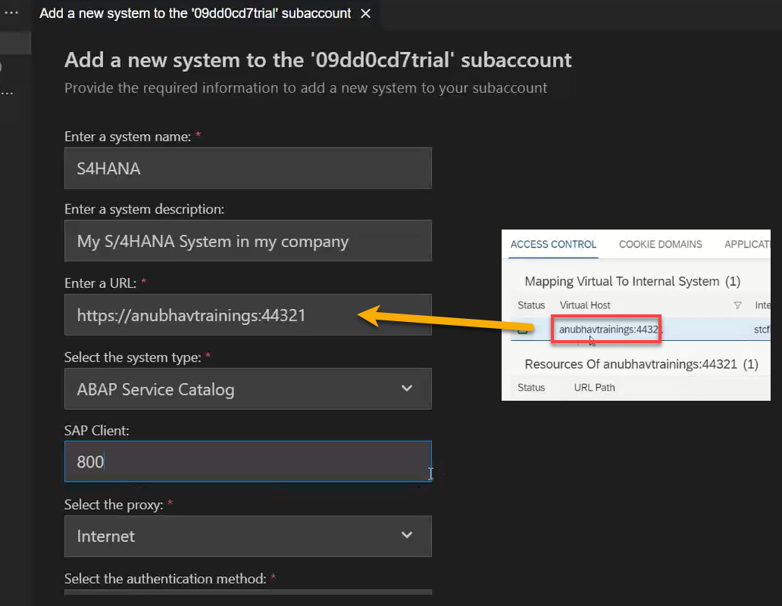
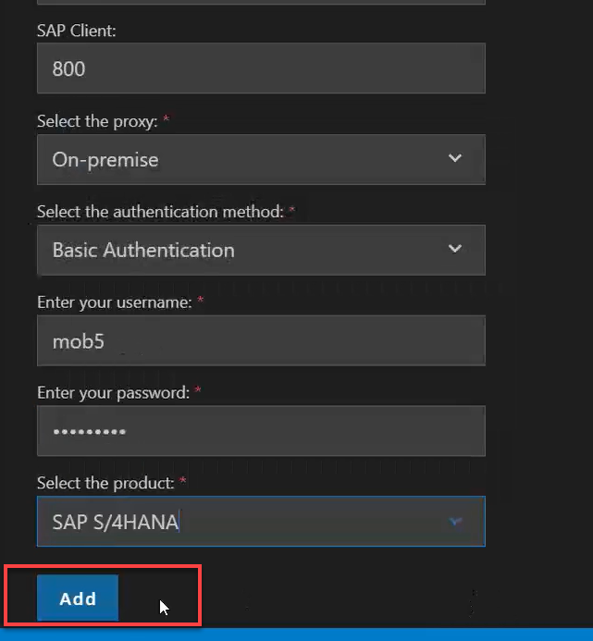
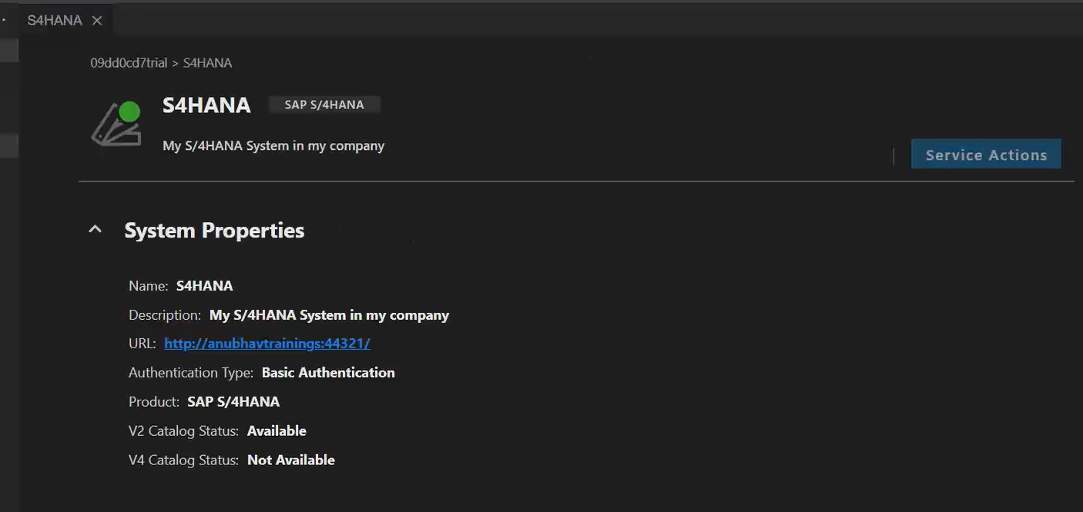
Creating Destination Inside BAS
To create the destination directly using BAS follow the step:
Start your BAS tool and in that go to the service center in the left side bar.
Then under the SAP SYSTEM section choose your subaccount and click on plus button +
Fill the details as shown and press Add. You can create a new Project for the template to test this destination.

Slide 17
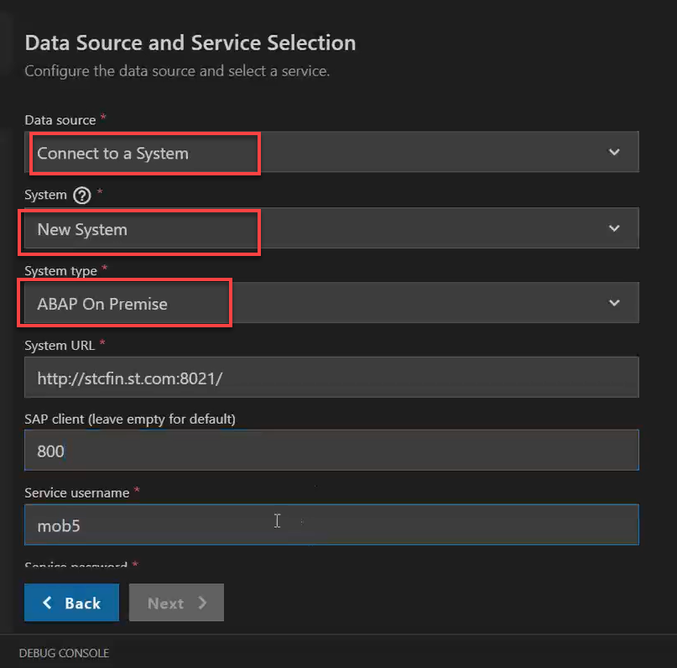
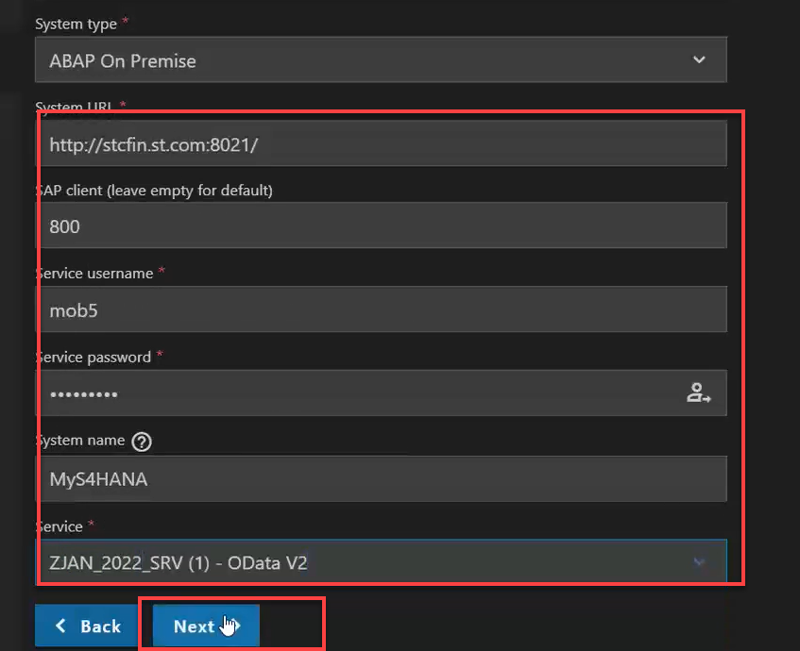
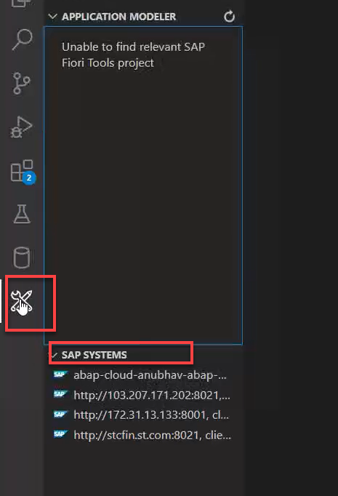
Connecting system to the VSCode
Now if we want to connect our system to the vscode we don’t need the Cloud Connector, because the VS code is already running in our local system and in our local system we can use the VPN to access our SAP System.
So to connect vs code to the system:
Open application generator using the command palette.
Create any type of project (let’s select the master detail).
In the Data Sources as Connect to a System
In system select New System and system type as ABAP on Premise
And then Enter the system detail.
Then complete the project setup.
After that you can see the created system in the Fiori Tools option in the left side bar, under the SAP SYSTEM.

Slide 18
CORS – Cross Origin Resource Sharing
It is a browser security policy which prevent us connecting to a domain while running web page on a different domain.
Browser
S
https://localhost:8080
Proxy
Facebook.com
Google.com
Another Server
http://103.207.171.202:8021/sap/opu/odata/sap/ZOCT_ODATA_SRV/$metadata
https://www.npmjs.com/package/@sap/ux-ui5-tooling

Slide 19
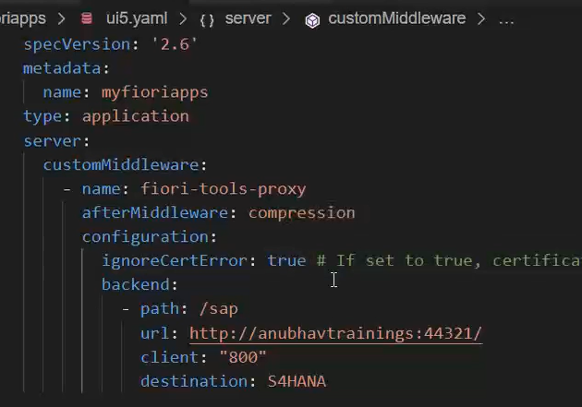
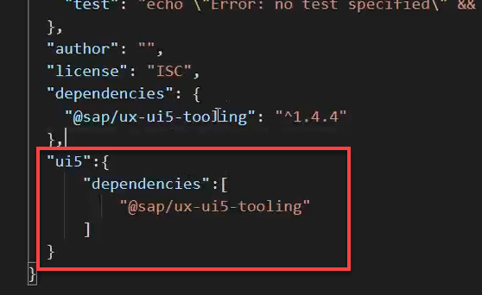
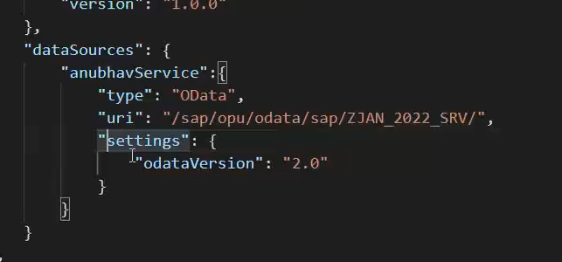
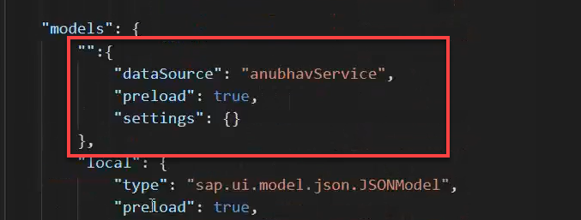
Integrating OData in Fiori App
Before we start OData integration in our fiori project we need have to check that, we have added the package.json and ui5.yaml file in our project, if the we haven’t add then run these commands in the terminal to added these files:
npm init
ui5 init
Now we have the required file in the project, we can proceed the integration.
Go to ui5.yaml file and add the middleware code (given in the link) to the file and save it.
Add the dependency of sap/ux-ui5-tooling to the project using the command: npm install @sap/ux-ui5-tooling
Now add the ui5 section in the package.json file to specify the dependencies related to ui5.
Now go to the manifest.json file we have to add a dataSource under the sap.app section and then create a default model to consume the service in UI.

Slide 20
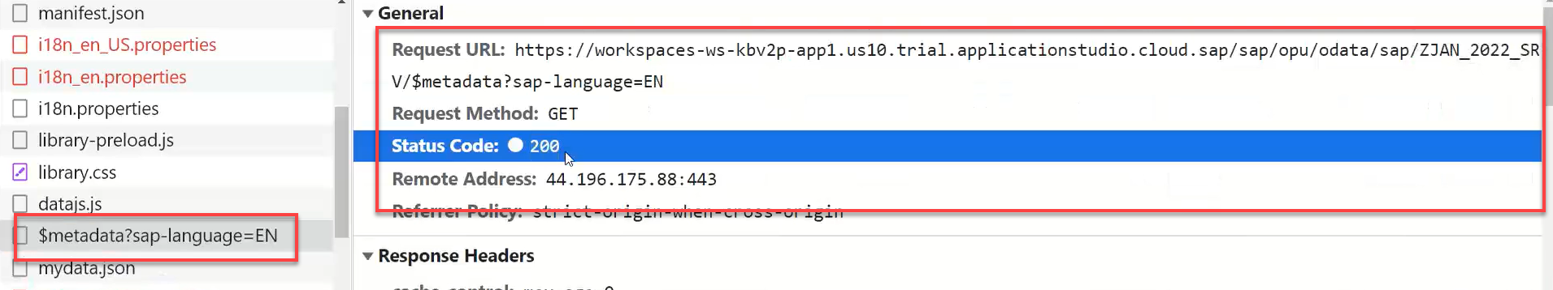
Hands – on: Consume OData service
Follow the steps given in the previous slide to configure the fiori app in BAS to consume the Odata service.
Once the configuration is complete the app will call the metadata of the application which we can check in the Network tab in browser.
Code Link:-
ui5.yaml
package.json
manifest.json

Slide 21
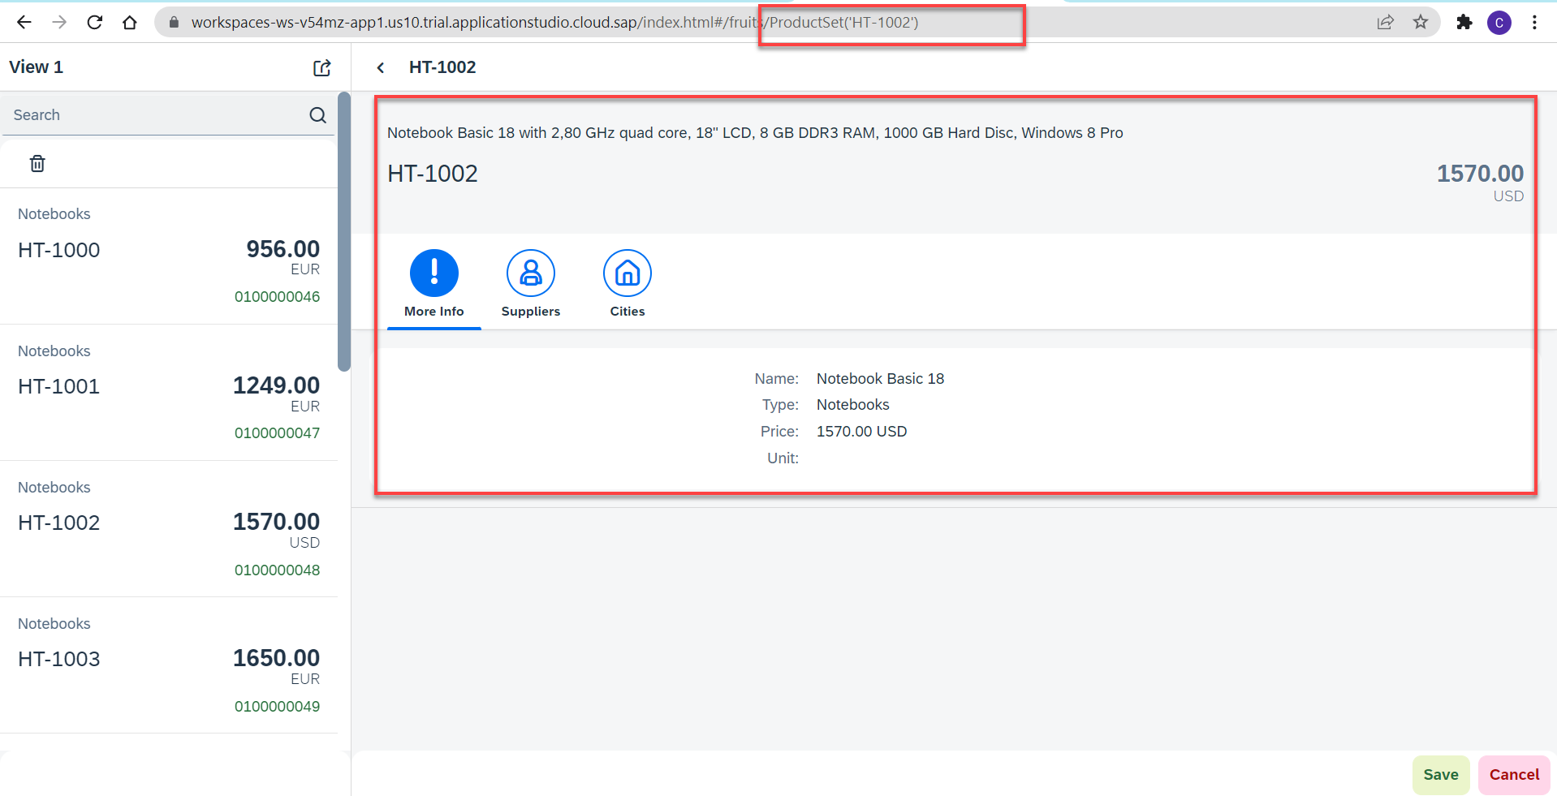
Hands – on: Binding the app with odata
Now to get the data into the application we have to change the binding of the application. Initially the app is bind to the fruits data, so we have to bind it form the OData properties.
We also have to change the Route Match Handler (herculis) code in the View2 controller.
We have to add the growing property to the list to support pagination.
And we also have to change the search function to support the filter on the CATEGORY.
Code Link:-
View1.view.xml
View1.controller.js
View2.view.xml
View2.controller.js
moreInfo.fragment.xml

Slide 22
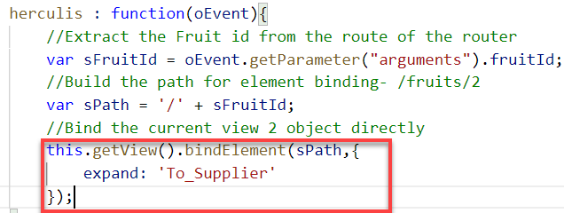
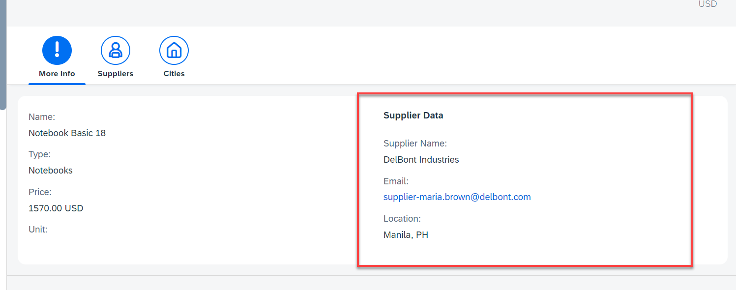
Hands – on: Getting the Associated Data
Now we want load the associated data on the UI. To do that we will create a new form in the moreInfo Fragment and in that form we will load the Supplier data of the product.
We will also have to make some changes in the Binding of the View2 to load the dependent data.
Code Link:-
View2.controller.js
moreInfo.fragment.xml

Slide 23
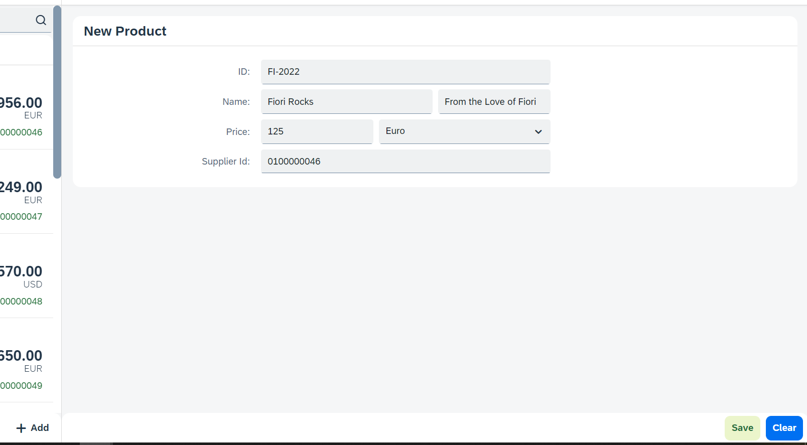

Hands – on: Making POST call from UI
Now we will add a new view named as Add. In this view will add a simple form to enter the product details and then on press of the Save a new Product will be created in the backend.
We will also add a Clear button to clear the form.
Code Link:
View1.view.xml
View1.controller.js
Add.view.xml
Add.controller.js
manifest.json

Slide 24

Hands – on: Making Update call form UI
Now will add a functionality to update a Record form the backed. But before that we will have to load the record in the form and then we will update that recode and save it.
Code Links:-
Add.view.xml
Add.controller.js

Slide 25

Hands – on: Making Delete call from UI
Now we want to delete a selected record form the UI. To do that we have to make a delete button in the UI and on press of that delete button the record will be deleted form the backend.
Code Links:-
Add.view.xml
Add.controller.js

Slide 26

Hands – on: Calling the Function Import
Now load the most expensive data on the Add View. To do that we will add a button next to the Product ID field and on press of that button we will make a call to the Most Expensive Products function which we have created. And then load the data into the form.
Code Link:-
Add.view.xml
Add.controller.js

Slide 27
Delivering Fiori Apps
Currently the Application we have developed is in our local system (VS Code or BAS). Now we want this app to be accessible by other people in our company, to do that we have to deploy this application to our ABAP environment or cloud platform where it can be accessed by others.
BAS/VS Code
GitHub
Development Team
destination
SCC
DEV
QLT
PROD
BSP App
BSP App
BSP App

Slide 28







Delivering Fiori Apps
2
ui5 build
Development Environment
(BAS, VSCode, etc.)
1
git push
dist
GitHub Repository
3
npm run deploy-config
Developer
deployment configuration
End Users
4
npm run deploy
ABAP Repository
PROD (P)
DEV
Quality(Q)
Transport Request
Transport Request
Admin
Launchpad and Launchpad Designer

Slide 29

Adding deployment Configuration to App
Steps to configure the Application to deploy the Application on ABAP Environment.
Open the terminal in BAS or VS Code and go to your project folder.
Open terminal in you project folder.
Write command ui5 build or npm run build and press enter to build your project it will create a dist folder.
Now write command npx fiori add deploy-config to configure the project for deployment.
Select a target ABAP system … http://103.207.171.202 in your case your hostname will come in this step.
Enter the ABAP system client number …
Enter a username …
Enter a password …
Enter an application name …
Enter a description for the application …
Enter a package for the deployed application … $TMP
Now to deploy the application to the ABAP repository we use the command npm run deploy.

Slide 30
Title
Content

Slide 31

End of Day 10

Slide 32

Questions

Slide 33

Anubhav Oberoy

Slide 34


We’re committed to empower you to be
Most Desirable Resource
through powerful training solutions.
We build the workforce of the future.
250+
Corporate Clients
30,000+
Learners Trained
25000+
Learners Placed
FREE WEBINARS
Sign up for free webinars with industry experts every fortnight!
Enroll Now!
Contact us today!
https://anubhavtrainings.com/

Slide 35




More from AnubhavTrainings.com

Slide 36
Title
Content

